Slide 1
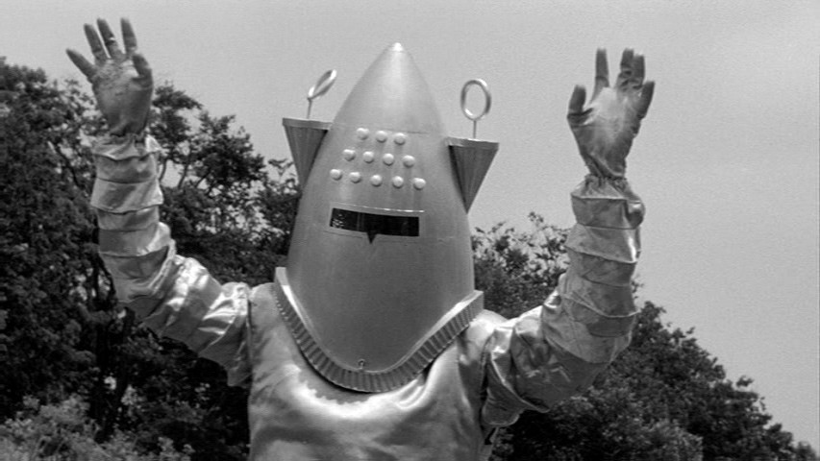
Detecting Exoplanets with Artificial Neural Networks
By:
Zach Green

Slide 2
Goal:
Train a neural network to detect exoplanet transits by analyzing the brightness from stars.
Implement on a sample of 5000 stars to generalize results to the visible night sky.
A planetary transit occurs when a planet passes directly between its star and our viewpoint.
Why is this a difficult problem:
Too much data for human eyes.
Too far away to see them directly.
Weird things in space create false signals:
Solar flares, binary stars, sunspots, cosmic dust clouds.

Slide 3
Kepler Spacecraft
Kepler was built to estimate the frequency of earthlike planets in the Milky Way.
Relevant data:
Corrected flux magnitude.
Measurements 30m apart.
Campaign 4 data:
Objects 3,000 light years away.
Milky way diameter is 150,000ly.

Slide 4
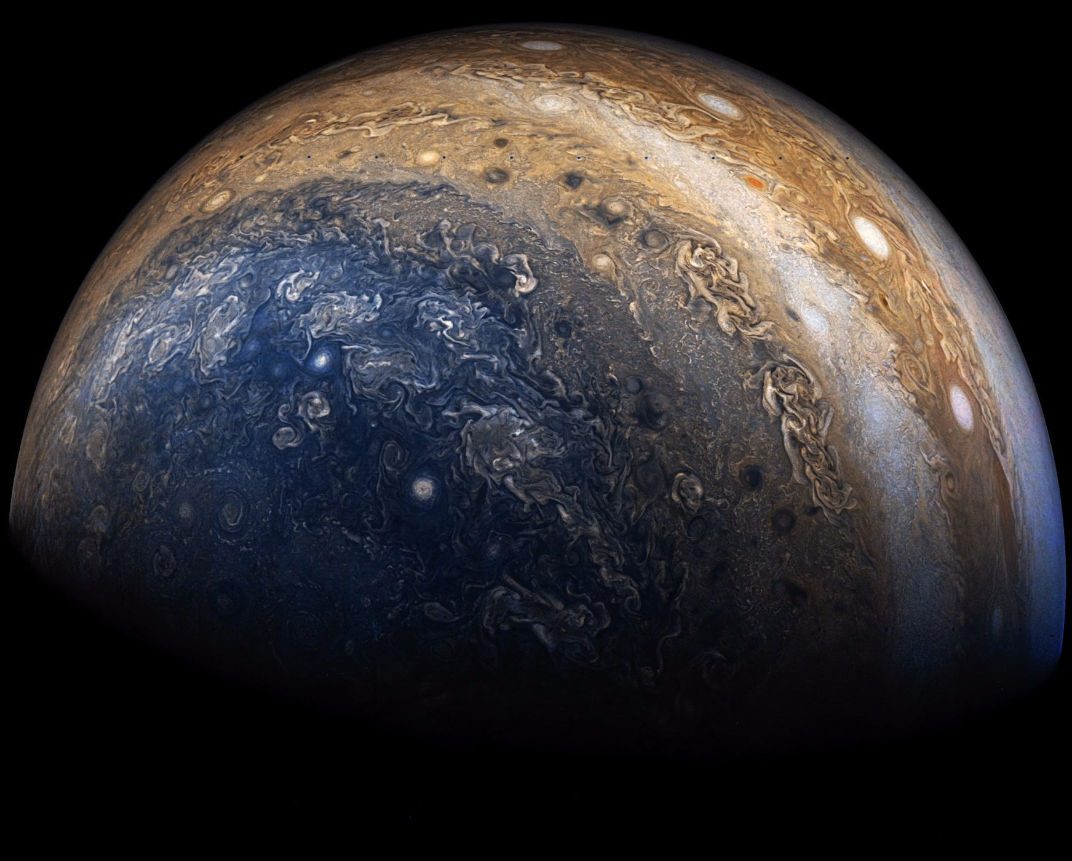
Getting Data
There is a lot of data available.
It could take weeks just to download all of it.
Used 250gb downloaded from NASA’s API.
Wget scripts.
Sifting through files for corrected flux levels.
Data in the form of .fits files.
Light curves for confirmed planets randomly selected from several timeframes.

Slide 5
Warning: Too much data may lead to space madness.

Slide 6
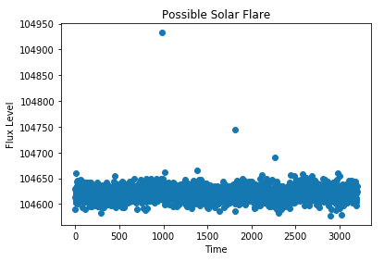
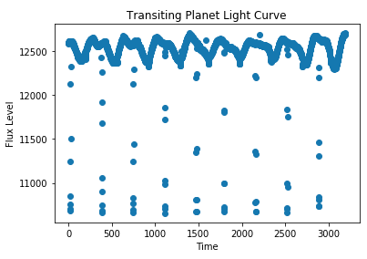
Exploring and Cleaning Data
Most planets discovered this way have very short orbits.
Solar flares are common.
Our sun has between one a week and several a day.
Cleaning missing values.
Longer periods of missing data were filled by skipping to the next non-null value.
Isolated missing points calculated from two adjacent points.

Slide 7
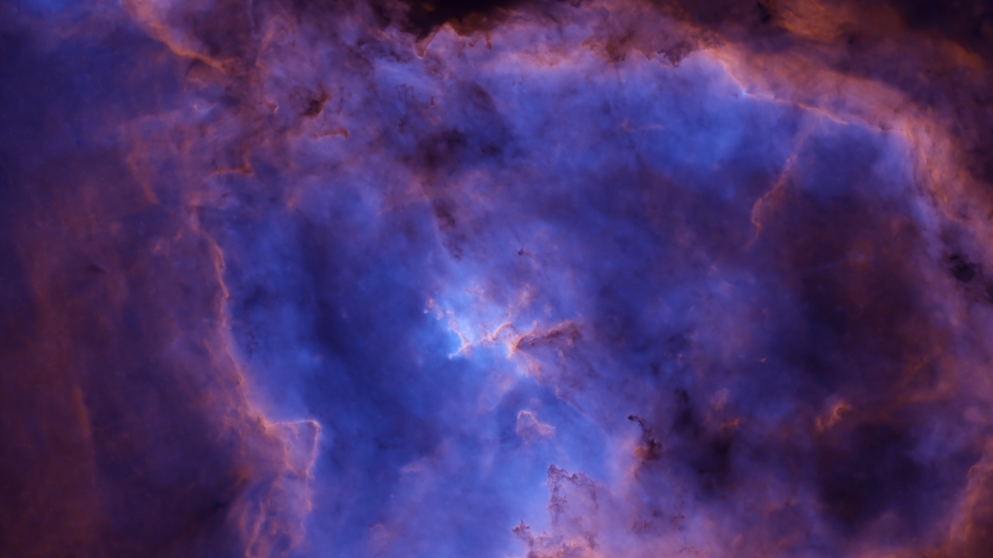
Preprocessing:
Normal scaling to compare stars of different brightness.
This preserves ”unusual” events.
Mixing in confirmed planets to the training data.
Give the neural network more to learn from.
Put on the same time scale to compare data from different sources.
66 days.

Slide 8
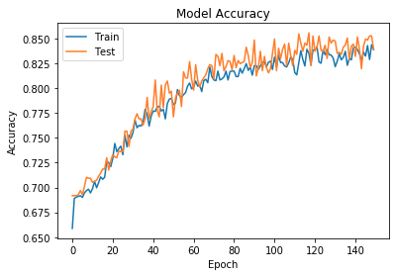
Neural Network
One Dimensional Convolutional Neural Network.
Looks over the light curve and learns what transits look like.
Topology:
3 convolutional and pooling layers.
2 hidden layers.
Performance:
85% accuracy on training holdout.
Baseline 31%.
Up to 15 times better than chance on unseen data.

Slide 9
Results:
How many stars in the night sky have transits?
40 actual planets in test set.
Predicted 98 planets.
12 actual planets predicted.
Performance
85% accuracy on training holdout.
Baseline 31%.
Up to 15 times better than chance on unseen data.
Limitations:
Can only make conclusions within campaign 4 sample.
High false positive rate.
87.7%
Excludes some stars with planets.

Slide 10
What we Really Want to Know:
Are there aliens?
Did they make the pyramids?
How many earth-like planets in habitable zone?
Estimated 40 billion in the Milky Way.
Estimated 100 billion total planets.
Typical planet size:
Between the size of Earth and Jupiter.
Typical orbital period:
Most are less than 100 days.

Slide 11
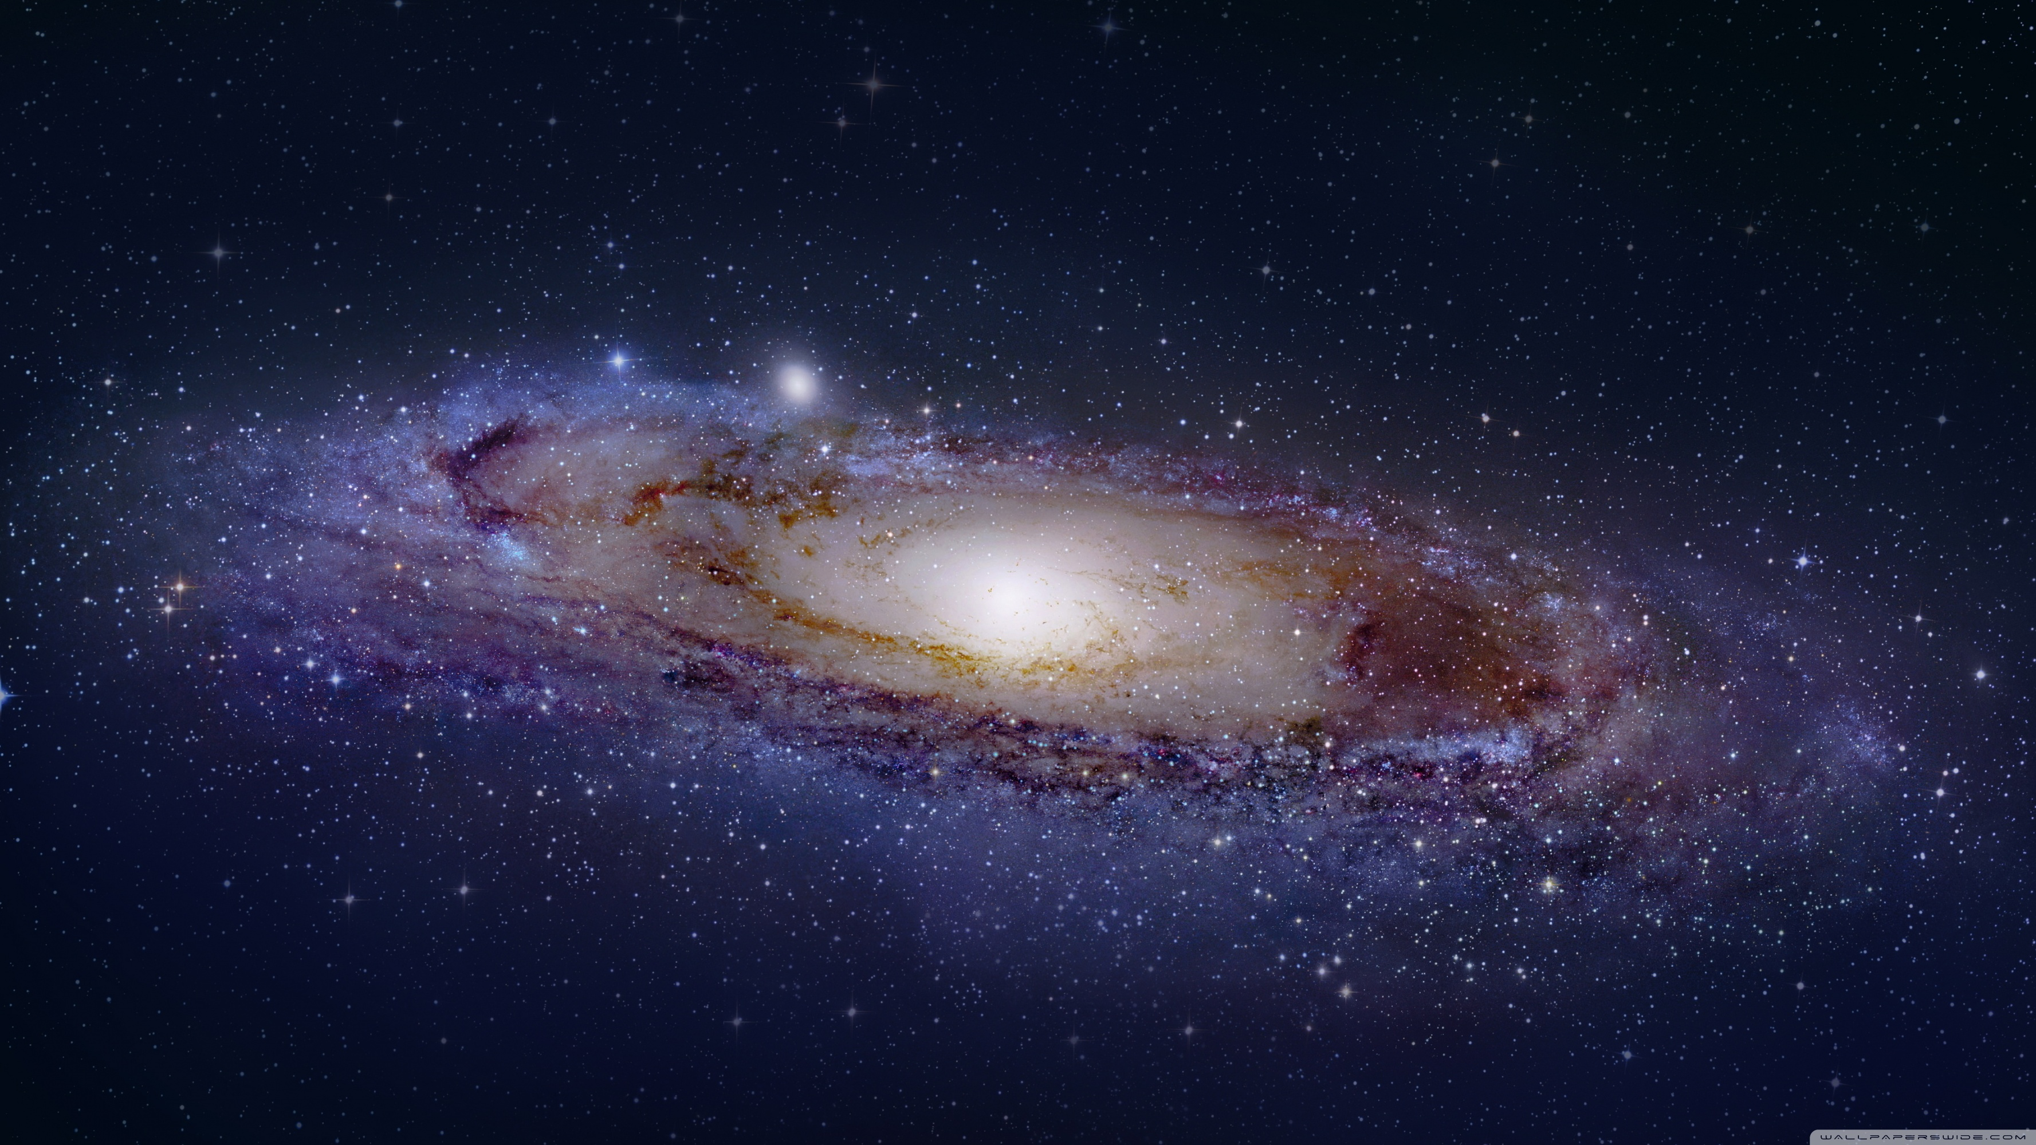
Directions for Further Study:
Validate with data from other telescopes.
Randomize data source.
What other things can be found with this data?
Try applying clustering?
Can we detect Dyson spheres?
Exomoons?
Bring in information about candidate planets.
Use other methods of planet detection.

Slide 12
Questions?

